Slide 1
Personality

Slide 2

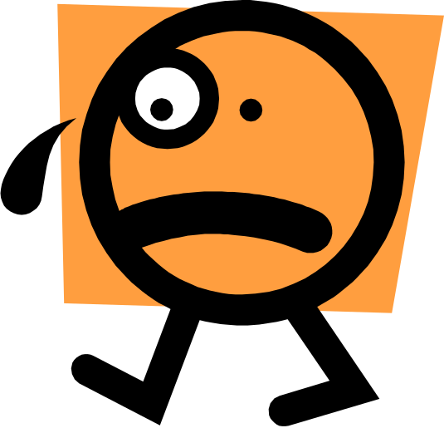



emotional
insensitive
pleasing
Intuitive
Extrovert
overbearing
hasty
introvert
emphatic
rational
Our Personality shapes our behaviour….

Slide 3
What is personality?
Does not imply charm
Positive attitude to life
Smiling face
Psychologist say: it’s a dynamic concept describing the development and growth of a person’s whole psychological system

Slide 4

Personality
The sum total of ways in which an individual reacts to and interacts with others – mostly described in terms of measurable traits that a person exhibits
The combination of psychological traits we use to classify & describe a person in terms of characteristics such as quiet, passive, loud, aggressive, etc.

Slide 5
Is personality determined by heredity or environmental factors?
Heredity refers to factors determined at conception = (physical stature, facial attractiveness, gender, temperament, energy level) i.e. biological, physiological, psychological (who your parents are)‏
Heredity approach says: An individual personality is determined by genes (molecular structure of the genes located in the chromosomes).
Three researches lend some credibility to this attribution that ‘heredity plays an important role in determining an individual’s personality’.

Slide 6
Studies of Young children
Evidence demonstrates that traits such as shyness, fear, aggression can be traced to inherited genetic characteristics.
Suggesting that personality traits may be built into the same genetic code that affects factors such as height or hair colour.

Slide 7
Studies of twins - (separated at birth)‏
Researchers studied 100s of identical twins separated at birth and raised separately.
If heredity plays no role in influencing personality, we expect to find few similarities between the separated twins.
One set of twins separated for 39 years
Found to drive the same model and colour car, chained smoked same brand of cigarette, owned dogs with same name, vacationed in the same place
Twin studies suggests that parental environment doesn’t add much to our personality development.
Further research shows that identical twins reared apart have similar job satisfaction levels even if their jobs are completely different.

Slide 8
Environmental factors
Culture in which we are raised
  Culture sets the norms, values, attitudes passed from one generation to the next which is consistent over time.
  e.g. North Americans tend to be more ambitious and aggressive in comparison to other cultures that calls for cooperation, priority of family over work and career
Norms among family, friends, social groups

Slide 9
Personality traits
Early work on the study of personality centred around attempts to identify or label enduring characteristics that describe an individual’s behaviour – such as: shy, aggressive, submissive, lazy, ambitious, loyal, timid, etc. (called personality traits).
The more consistent and frequent the trait, the better it describes the personality of the person.

Slide 10
Why the importance of traits?
Helps in employee selection
Match people to jobs
Guide career development decisions
Early efforts to identify Primary Traits resulted in a Long List of Traits that could not be generalised and therefore hard to implement.

Slide 11
Myers-Briggs Type Indicator
Most widely used personality-assessment instrument in the world
A 100 question personality test that asks people how they usually feel or act in a particular situation.
Individuals are classified as extroverted or introverted (E or I), sensing or intuitive (S or N), thinking or feeling (T or F), and judging or perceiving (J or P)

Slide 12
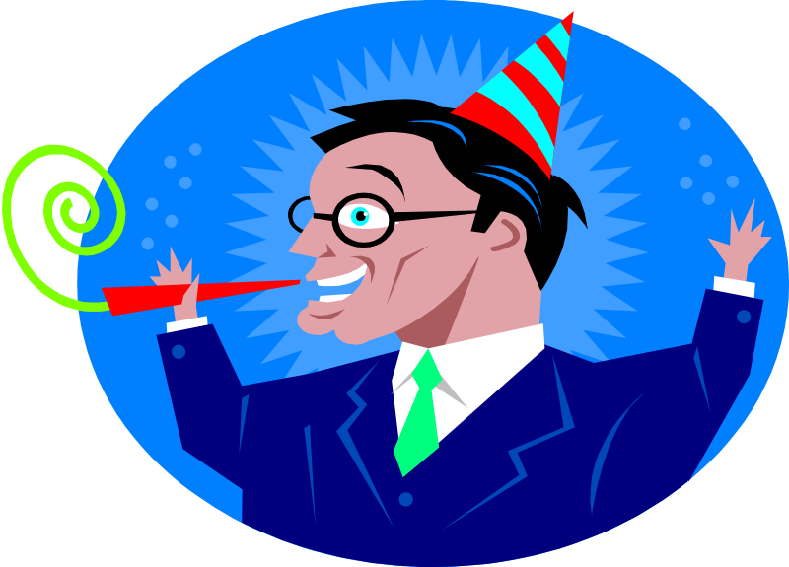
Extroverted vs. Introverted
Extroverts are outgoing, sociable, assertive
Introverts are quiet and shy

Slide 13

Sensing vs. Intuitive
Sensitive types are practical and prefer to focus on details, routine, order
Intuitives rely on unconscious processes and look at the big picture

Slide 14

Thinking vs. Feeling
Thinking types use reason and logic to handle problems
Feeling types rely on their personal values and emotions

Slide 15

Judging vs. Perceiving
Judging types want control and prefer their world to be ordered and structured
Perceiving types are flexible and spontaneous

Slide 16
Classifications combined into 16 personality types
INTJ’s (introvert, intuitive, thinking, judging) are visionaries
Usually have original minds, great drive for ideas and purposes
They are skeptical, critical, independent, determined and stubborn
ESTJ’s (extrovert, sensing, thinking, judging) are organisers
They are realistic, logical, analytical, decisive
Natural head for business
Like to run activities

Slide 17
ENTP (extrovert, Intuitive, thinking, perceiving) are conceptualisers
They are innovative, individualistic, versatile, attracted to entrepreneurial ideas.
Creators of Apple, Sony, FedEx, Honda, Microsoft were found to be NTs

Slide 18
Problems with MBTI
Forces a person to be categorised as one type or another (no in-between)‏
Results of MBTI tend to be unrelated to job performance, should not be used as a selection test for prospective job candidates

Slide 19
The Big-Five Model
Five factor model of personality
A lot of research supports that five basic dimensions underlie all others and cover most of the significant variation of human personality
Extroversion
Agreeableness
Conscientiousness
Emotional Stability
Openness to Experience

Slide 20
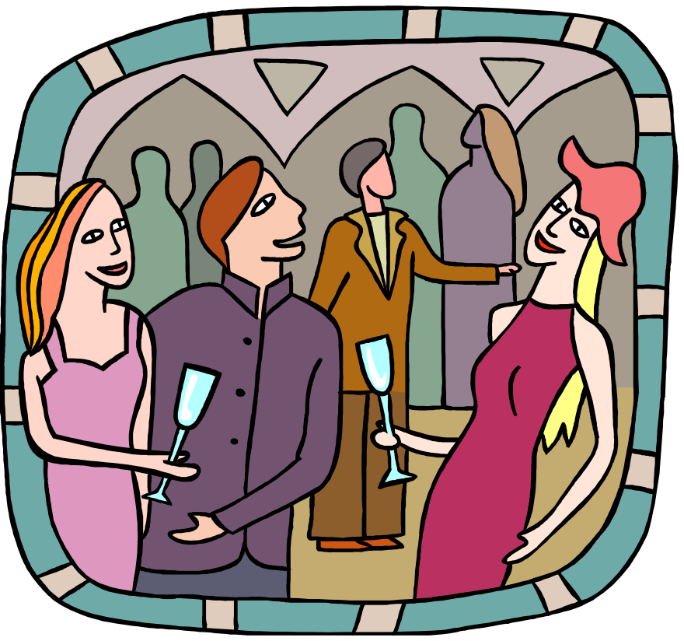
Extroversion -
Captures one's comfort level with relationships
Tends to be gregarious, assertive, sociable
Introverts tend to be timid, reserved and quiet

Slide 21
Agreeableness –
Refers to an individual's propensity to defer to others
Highly agreeable people are cooperative, warm, trusting.
Disagreeable people are cold, antagonistic
Conscientiousness - a measure of reliability
Is responsible, organised, dependable and persistent

Slide 22

Emotional stability -taps a person's ability to withstand stress
High scores = calm, self confident, secure
Low scores = nervous, anxious, depressed, insecure

Slide 23

Openness to experience - addresses an individual's range of interests and fascination with novelty
Creative, curious, artistically sensitive
Other end = conventional and comfort in the familiar

Slide 24
Measuring Personality
Self Report Surveys
Observer Ratings Survey
Projective Measures (Thematic Aperception Test)‏

Slide 25
Self Report Survey
Most common way to measure
concern 1: individual might lie to create good impression
concern 2: accuracy of the method (good candidate may have been in a bad mood while filling up.

Slide 26
Observer Ratings
Provides independent assessment of personality
A co-worker or someone else could give the rating for the individual
concern 1: May give wrong rating
concern 2: relationships may prejudice report

Slide 27
Projective Measures
Rorchach Inkblot Test : individual is supposed to state what the inkblot resemble.
TAT uses a series of drawings or photos on cards and the individual writes a story about each picture.
concern 1: assessment is fraught with perceptual biases. Therefore very rarely used.

Slide 28
Personality attributes influencing OB
Core Self Evaluation:
  People differ in the degree to which they like/dislike themselves and whether they see themselves as capable and effective.
  Positive core self evaluation
    Like themselves, see themselves as effective, capable, in control of their environment
  Negative core self evaluation
    Dislike themselves, question own abilities, view self as powerless.
  Core self evaluation is determined by two elements: Self Esteem and Locus of control.

Slide 29
Self esteem:
Individual’s degree of liking/disliking self
Worthy/unworthy
High self esteem = positive view and capable
Low self esteem = susceptible to external influence : seek approval, conform to belief or behaviour of those they respect
Locus of control
Degree to which people believe that they are in control of their fate.
Internals: believe they control what happens to them
External: believe what happens is through outside forces like luck or chance

Slide 30
Core self evaluation & job satisfaction
Positive self evaluation
  see more challenge in the job = more job satisfaction
  Tend to get more complex and challenging jobs
  Attribute positive outcomes to their own actions
  Perform better as they set more ambitious goals
  Concern: overconfidence can lead to wrong/bad decisions

Slide 31
Machiavellianism
Named after Niccoli Machiavelli, wrote in 16th century on how to gain and use power.
Tendency to manipulate and maintain emotional distance. The ends justify the means
High Machs flourish in:
  Face to face interactions
  Situations allowing latitude for improvising
High Machs do well in jobs that
  offer rewards for winning,
  requiring bargaining skills

Slide 32
Narcissism
From Greek myth of Narcissus, a man so vain and proud he fell in love with his own image
In psychology, narcissism describes one who has a grandiose sense of self importance, needs admiration, sense of entitlement, is arrogant, likes to be the center of attention
Think they are better leaders while others rate them the worst leaders
Tend to be selfish and exploitive, others exist for their benefit
The difference between Larry and God, is that God doesn’t think he is Larry.

Slide 33
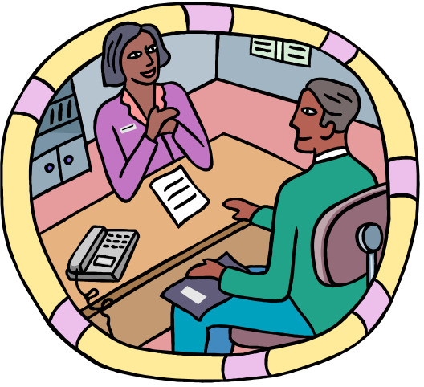
Self Monitoring
Individual’s ability to adjust / adapt his or her behaviour to external, environmental factors
High self monitors are capable of presenting contradictions between their public and private persona.
Likely to receive better ratings, can emerge as leaders, less committed to organisations
Low self monitors tend to display their true positions and attitudes in every situations = high behavioural consistency

Slide 34
Risk Taking
Willingness or propensity to take risks
High risk takers make quicker decisions and need less information in making their choices
Decision accuracy was the same for high and low risk takers
High risk takers are suitable for areas like stock markets or sectors needing quick decisions (not for accounting)‏
Donald Trump : start with almost nothing in 1960s – by 1980s made fortune – negative net worth of $850m – took risks on few assets – by 2004, Forbes estimated his net worth $2.6b.

Slide 35

Type A personality
Excessively competitive and experiencing a sense of time urgency
Chronic, incessant struggle to achieve more in less time
Type A’s
  Are always moving, walking, eating rapidly
  Feel impatient at the rate that events take place
  Try to do more than one thing at a time
  Cannot cope with leisure time
  Obsessed with numbers : measure their success in terms of how many/how much they acquired

Slide 36
Type B personality
Exact opposite of Type A
Rarely hurried by desire to obtain things
Type B’s:
  Never suffer from sense of urgency
  Feel no need to display or discuss their achievements unless really required
  Play for fun and relaxation rather than to exhibit their superiority
  Can relax without guilt

Slide 37
Type A’s operate in moderate or high levels of stress
Subject themselves to pressure and deadlines
Fast workers, work long hours
Rarely creative
Easier to predict their behaviour

Slide 38
Proactive personality
Actively take the initiative to improve on their present circumstances OR create opportunities for themselves.
Proactives have desirables that organisations want
More likely to be seen as leaders/ change agents
More likely to question status quo or voice their displeasure when situations are not to their liking

